Slide 1
Red Team – Week 3
Spring 2024 - 2024/02/28
Please sign in --->

Slide 2
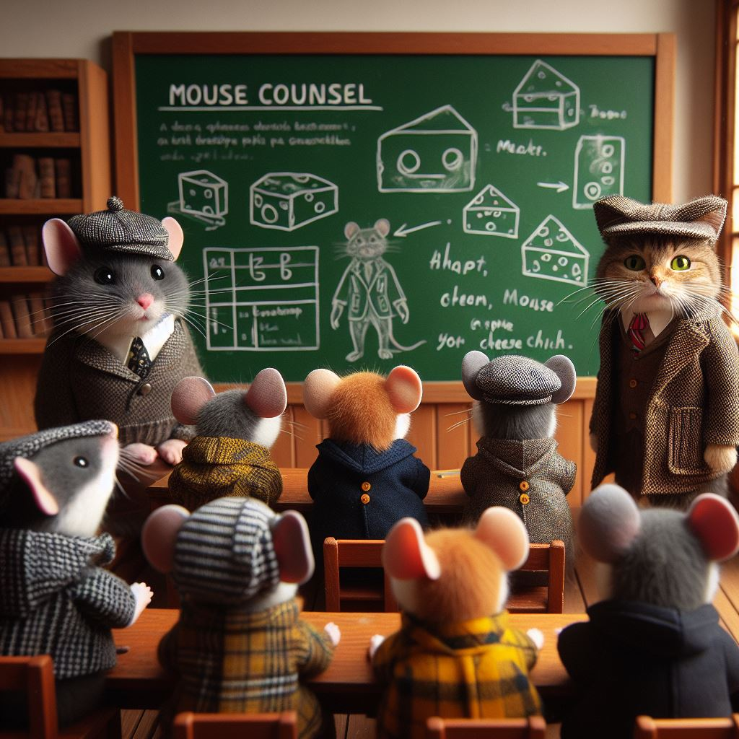
Any guesses as to the prompt?
Bing Designer

Slide 3
Generated by Bing Designer:
"mouse counsel in a tiny lecture hall wearing cute little tweed jackets and flat caps, with a chalkboard showing their plan for a great cheese heist, and a cat poorly disguised as a mouse among them."

Slide 4
TryHackMe:
Initial Access > Weaponization

Slide 5
Today's Plan
Task 1 Introduction
Task 2 Deploy the Windows Machine - Do this now, Kali too
Task 3 Windows Scripting Host - WSH - Brief Demo
Task 4 An HTML Application - HTA
Task 5 Visual Basic for Application - VBA - Pick one
Task 6 PowerShell - PSH
Task 7 Command And Control - (C2 Or C&C)
Task 8 Delivery Techniques - Rubber Ducky, you're the one
Task 9 Practice Arena

