Slide 1
CryptoHack
GH 224 - ᕕ(⌐■_■)ᕗ ♪♬

Slide 2
Timing information:
Meeting starts 6pm
Give 10 minutes for people to talk, show up late, and sign in.
Challenge | Time
Finding Flags | 1 minute
Great Snakes | 3-5 minutes
ASCII | 4 minutes
Hex | 2 minutes
Base64 | 5 minutes
Bytes and Big Integers | 5 minutes
XOR Starter | 7 minutes
XOR Properties | 15 minutes
Favourite byte | 15 minutes
You either know, XOR you don't | 15 minutes
TOTAL: | 72-74 minutes
Meeting starts ~6:10
Assume +20 minutes to explain 10 slides.
We finishes around ~8:30pm
with documentation.

Slide 3
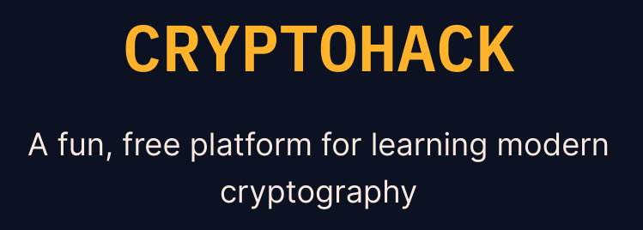
Sign In! 🖊️
Today, we’re doing CryptoHack!
You will need a computer with:
A browser
Python 3
pip
You might want to run
sudo apt install python3-pip
if you’re on a school PC.

Slide 4
Join the Discord
In case you haven’t already, please consider scanning this QR code to join the Discord
https://discord.gg/q985p7V3PG

Slide 5
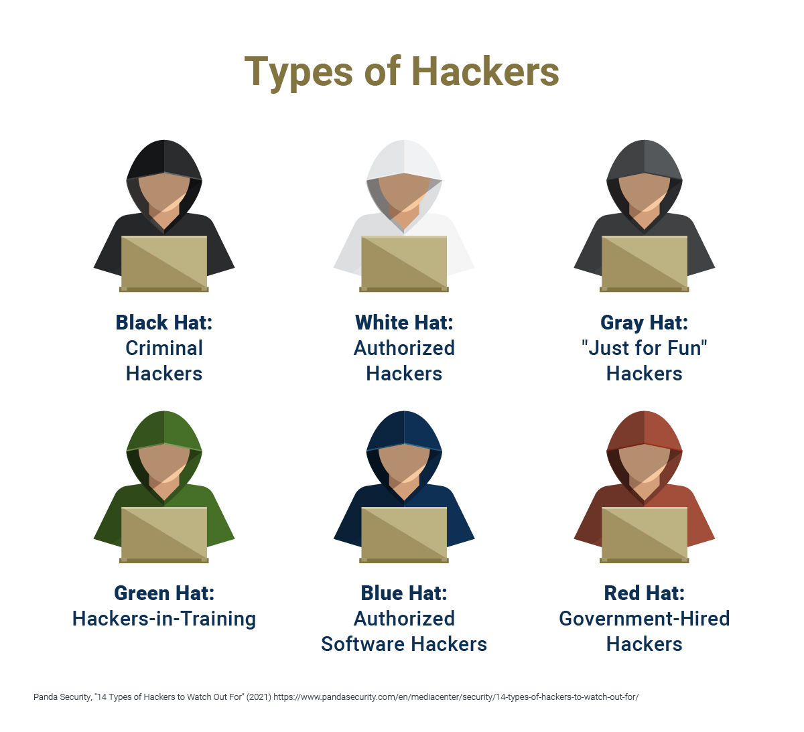
Sign our liability waiver
Ethical Hacking only!
Never attack a system without explicit consent.
“This waiver is to ensure that knowledge gained form NKCyber will not be used to attack any group or organizations without explicit permission. Failure to comply will result in ejection from the club and possible discipline from the school.
NKCyber is an educational club focused on sharing skills relating to cybersecurity. We do not condone the unethical hacking of outside organizations or individuals.”
https://cglink.me/2vf/s120

Slide 6
learn something new about cryptography
Goal for today:
motivation
Notes:
talk about how important cryptography is for modern life. examples:
all of https
online purchases

Slide 7
Let’s get hacking!!
＼(＾▽＾)／ ✨

Slide 8
Create your account
Go to https://cryptohack.org/register/
Solve the Caesar Cipher with dcode.fr/caesar-cipher
Verify your email!
Notes:
Note that Caesar is the roman emperor in question. cryptography has a long and storied history.

Slide 9
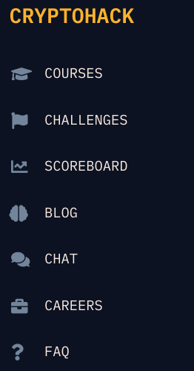
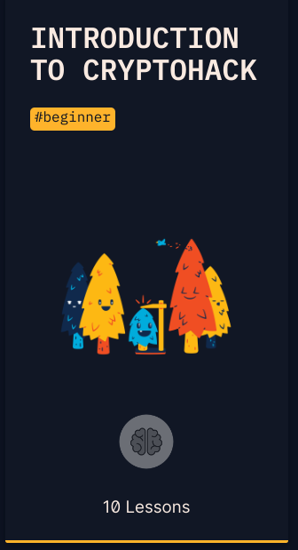
Do the first course
on cryptohack.org
Go to courses
Click on “Introduction to CryptoHack”

Slide 10
Challenge 1 - Finding Flags

Slide 11
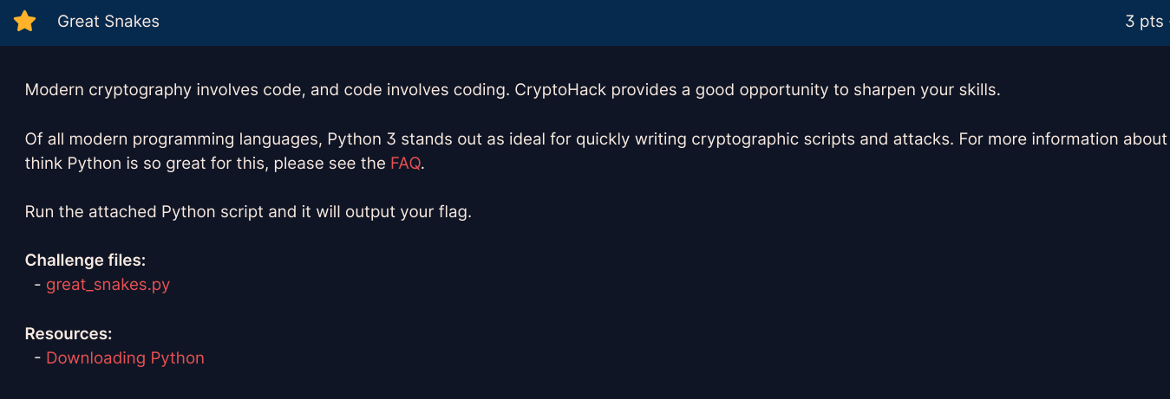
Challenge 2 - Great Snakes

Slide 12
Challenge 2 - Great Snakes
Notes:
Just download and run the file. Feel free to use tio.run or repl.it to run this online if you can’t use python on your computer.

Slide 13
Challenge 3 - ASCII
Give it a shot! You have 4 minutes!
Notes:
Note that the time is relative. If people aren’t finished / finish early, feel free to play with the timing.

Slide 14
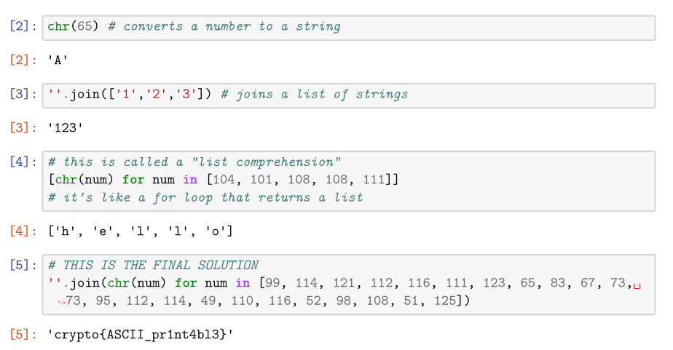
Challenge 3 - ASCII
Notes:
Note that you could also do this with a typical for loop, and print(num, end=””)

Slide 15
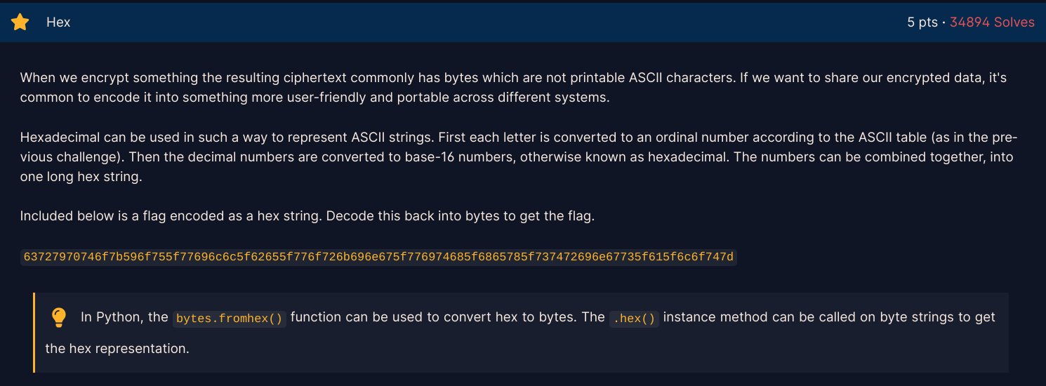
Challenge 4 - Hex
Give it a shot! You have 2 minutes!

Slide 16
Challenge 4 - Hex

Slide 17
Challenge 5 - Base64
Give it a shot! You have 5 minutes!

Slide 18
Challenge 5 - Base64

Slide 19
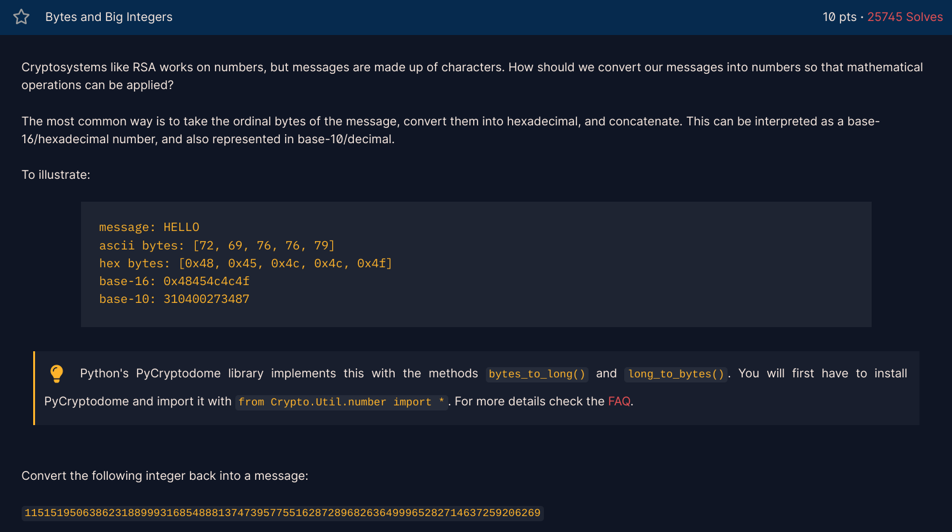
#6
You have 5 minutes!

Slide 20
Challenge 6 - Bytes and Big Integers

Slide 21
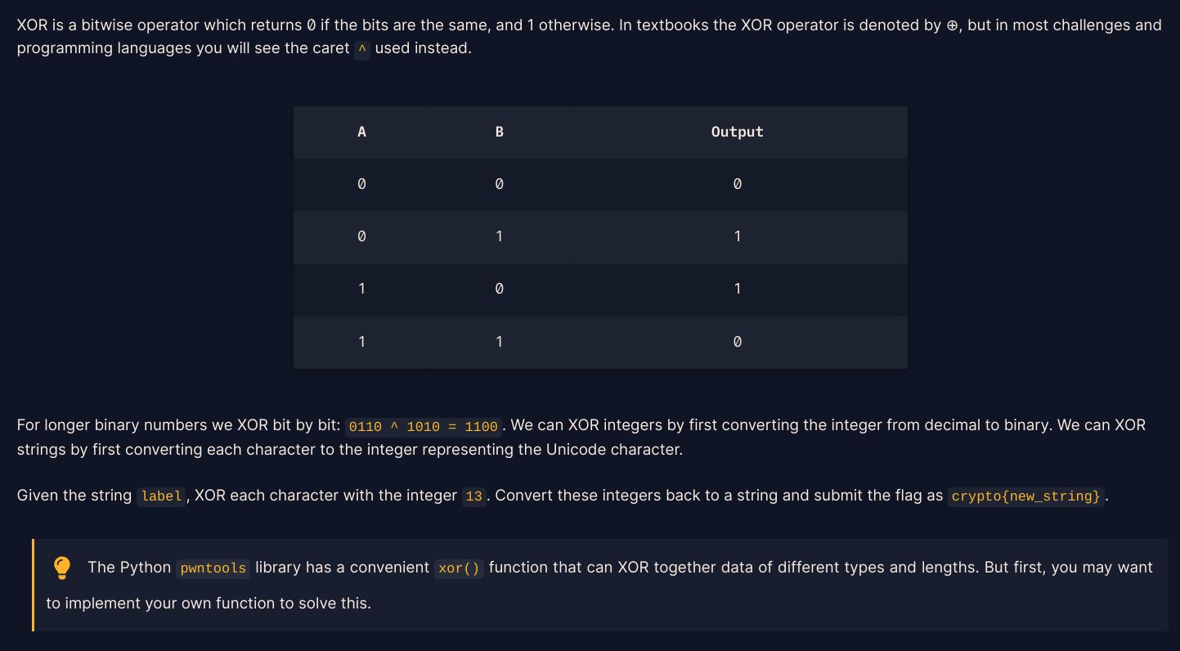
Challenge 7 - XOR Starter
You have 7 minutes!

Slide 22
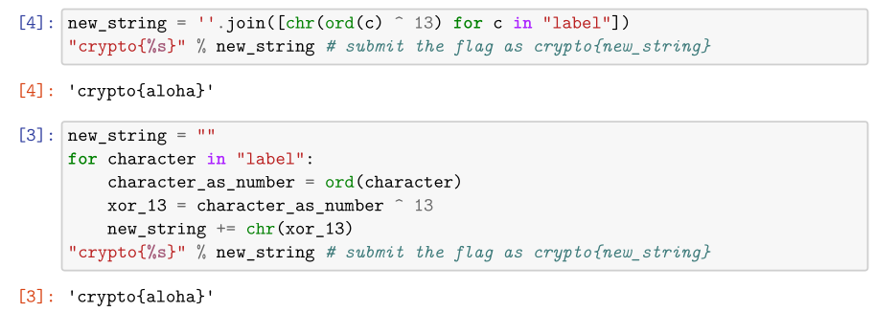
Challenge 7

Slide 23
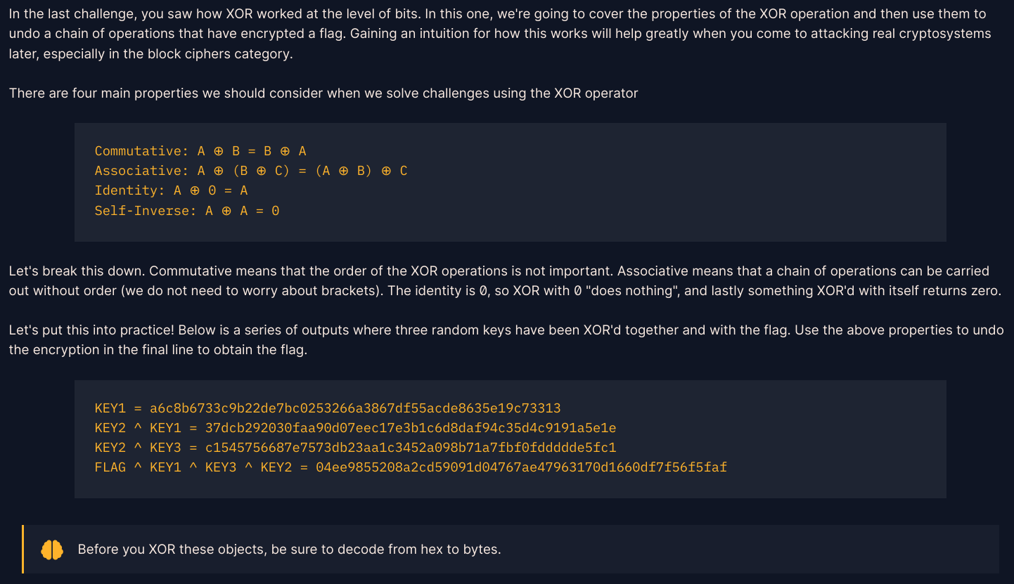
Challenge 8 - XOR Properties
You have 15 minutes!

Slide 24
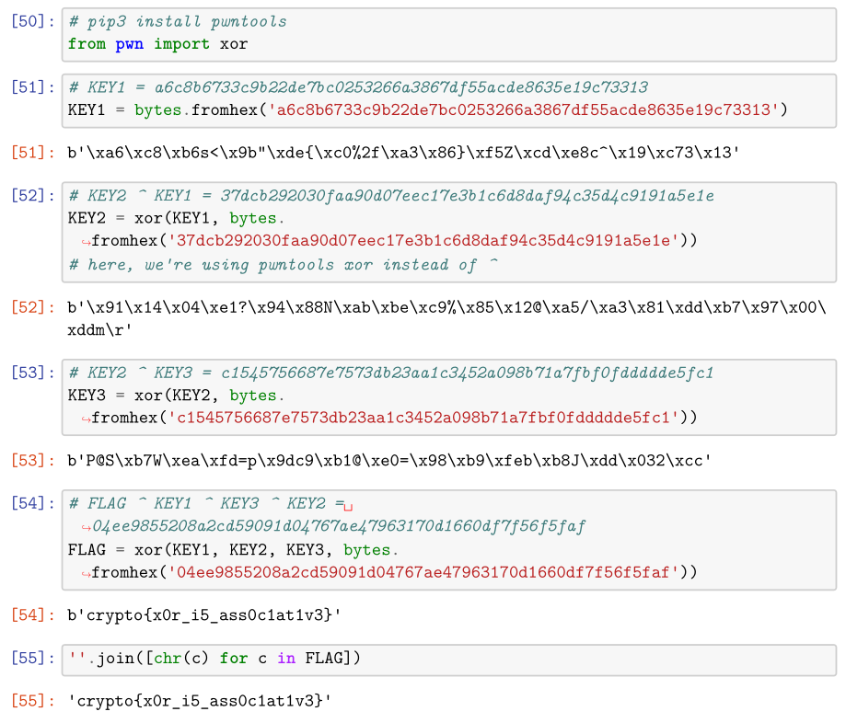
Challenge 8 - XOR Properties
(larger on next
slide in case this is
hard to read)

Slide 25
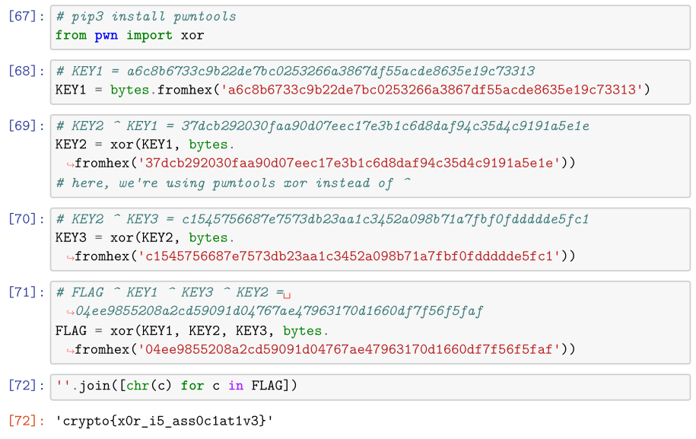
Challenge 8 - XOR Properties

Slide 26
Challenge 9 - Favourite byte
Remember the flag has to be in the format
crypto{RANDOM_STRING_HERE}
You have 15 minutes!

Slide 27
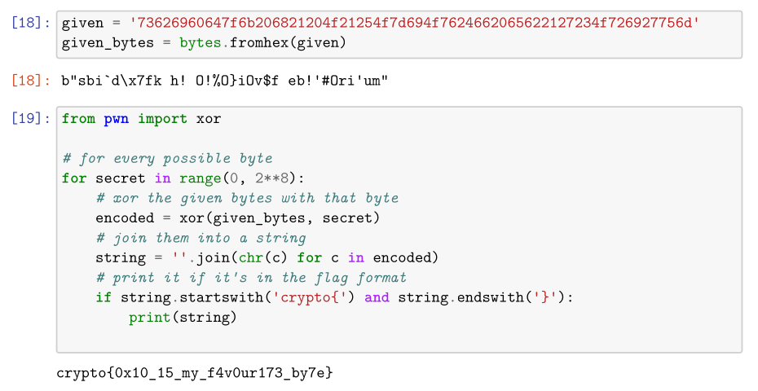
Challenge 9 - Favourite byte

Slide 28
Challenge 10
Not related to the favorite byte from the last problem!
You can XOR part of a string at a time.
Remember the flag has to be in the format
crypto{RANDOM_STRING_HERE}

Slide 29
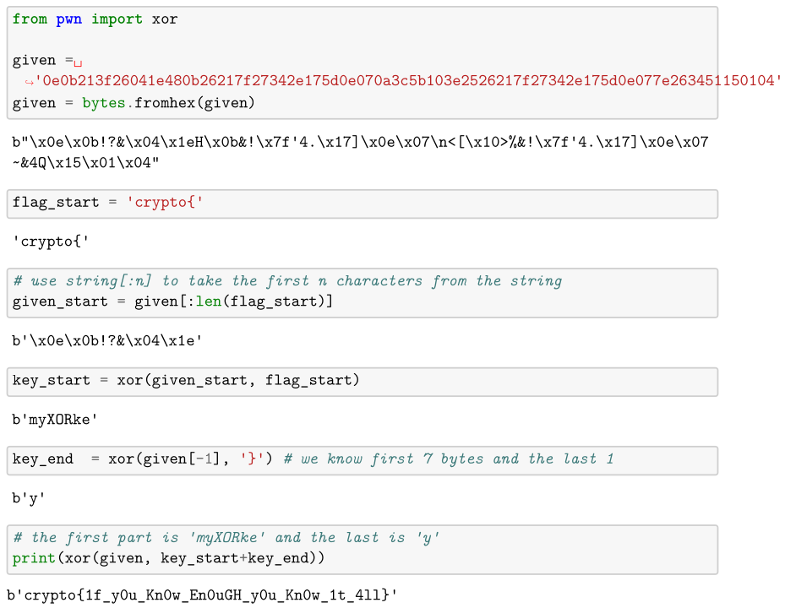
Challenge 10

Slide 30
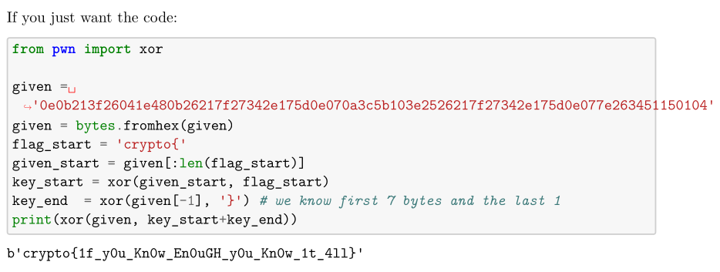
Challenge 10

