Slide 1
Independent Work
GH 224 - ᕕ(⌐■_■)ᕗ ♪♬

Slide 2
Timing information:
I don’t know how long this will take.
I plan to update this slide afterwards

Slide 3
Overview
Today, we’re experimenting with a new self-oriented format.

Slide 4
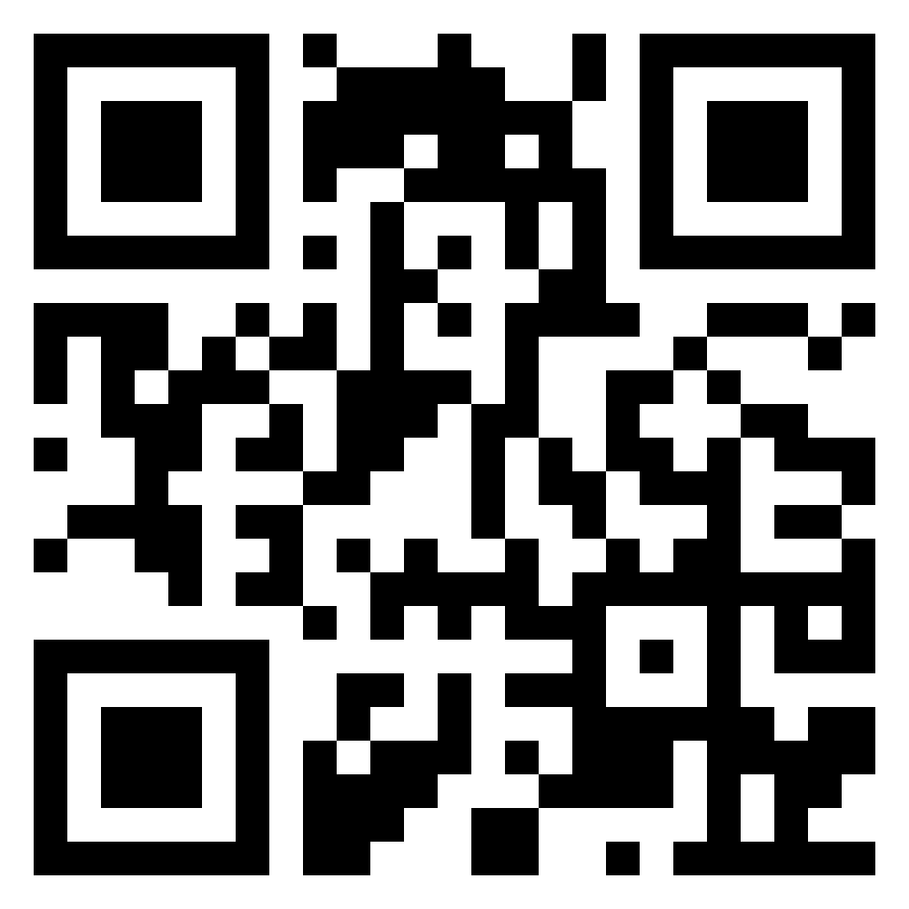
Join the Discord
In case you haven’t already, please consider scanning this QR code to join the Discord
https://discord.gg/q985p7V3PG

Slide 5
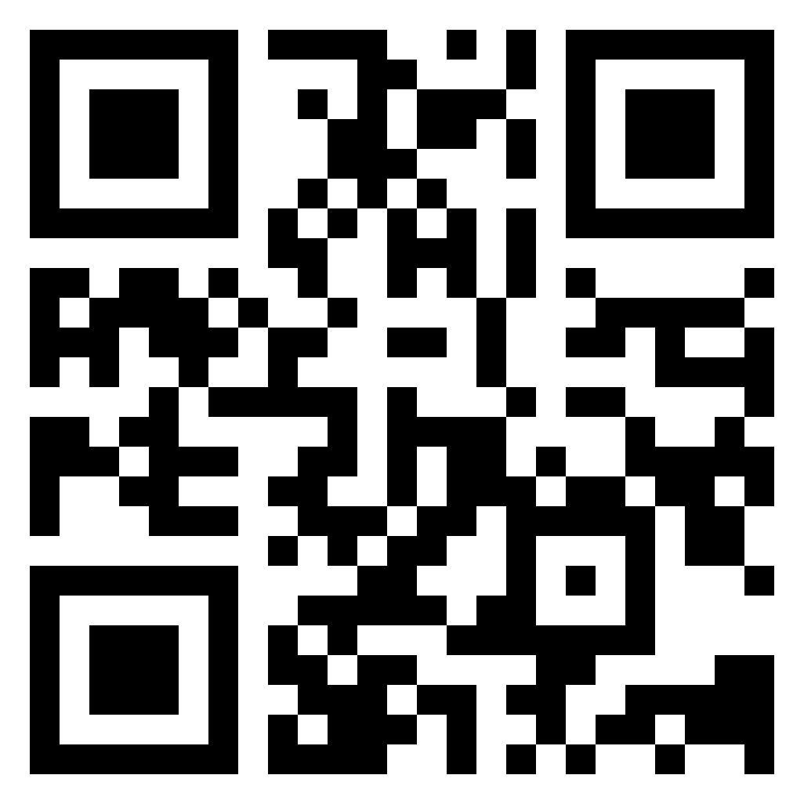
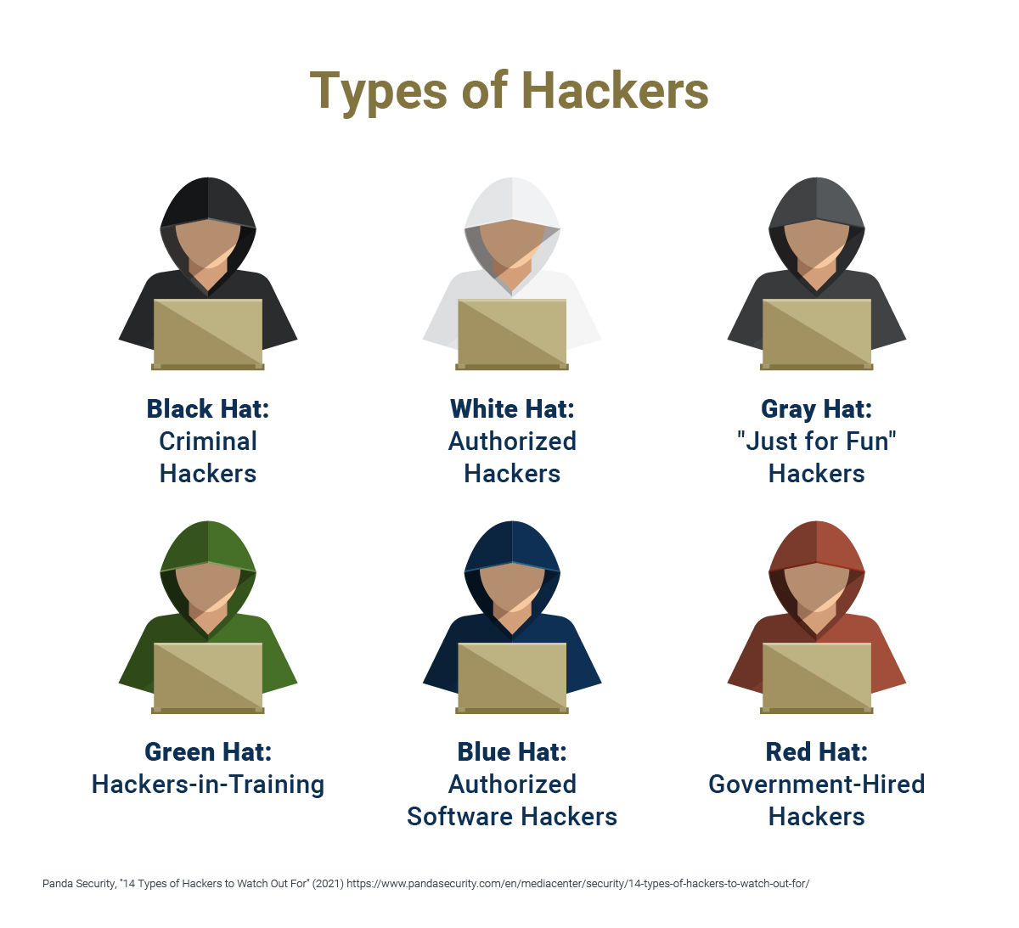
Sign our liability waiver
Ethical Hacking only!
Never attack a system without explicit consent.
“This waiver is to ensure that knowledge gained form NKCyber will not be used to attack any group or organizations without explicit permission. Failure to comply will result in ejection from the club and possible discipline from the school.
NKCyber is an educational club focused on sharing skills relating to cybersecurity. We do not condone the unethical hacking of outside organizations or individuals.”
https://cglink.me/2vf/s120

Slide 6
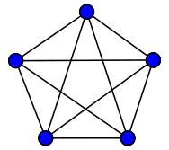
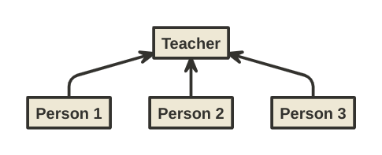
Change in format
Previous format:
Experiment today:
Notes:
Change from speaker oriented to group oriented

Slide 7
Pick a topic
https://zack.fyi/blog/hacking-resources.html
You have 100 options. You have 10 minutes.
Notes:
Y’all don’t have to pick the same topic; It’s okay to be different.

Slide 8
Let’s get started with what we picked!

Slide 9
Thanks for coming!!
Stretch, get a drink of water, etc.

